Slide 1
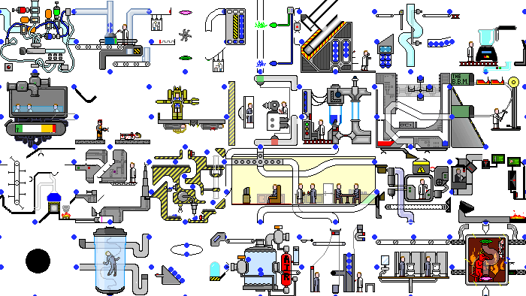
GPars:
Unsung Hero of Concurrency in Practice
http://playstationna.i.lithium.com/t5/image/serverpage/image-id/432281iDADEAFC04868CE5C?v=1.0

Slide 2
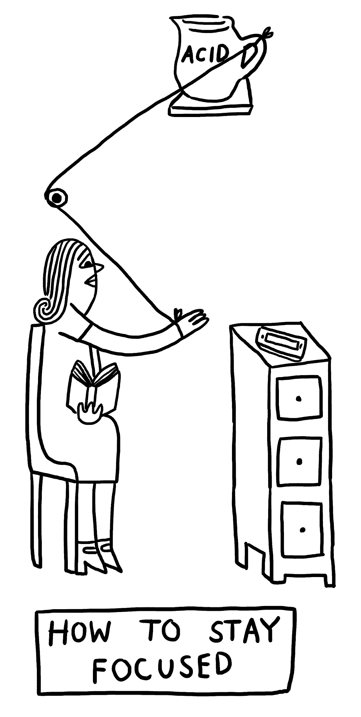
Focus for this talk
When it comes to concurrency and parallelism,
first things to appear in someone’s mind may be “Java Concurrency in Practice” by Brian Göetz, threads, java.util.concurrent, Fork-Join, parallel streams, reactive, Akka or MapReduce.
When it comes to Groovy, first things to appear in someone’s mind may be Gradle, Grails, Spock, DSLs or scripting.
http://www.theverge.com/2015/4/22/8381963/rube-goldberg-machine-contest-history-ideas

Slide 3
Focus for this talk
Great injustice is that you rarely meet GPars in both these lists.
Framework that provides high-level APIs and DSLs for writing concurrent and parallel code both in Java and Groovy
and support for concepts of map/reduce, fork/join, asynchronous code, actors, agents, dataflows (not all mentioned) deserves a little more attention, isn’t it?
http://www.theverge.com/2015/4/22/8381963/rube-goldberg-machine-contest-history-ideas

Slide 4
Focus for this talk
In this talk we will try to fix it. One by one, we will explore various use cases of GPars with all its pragmatism and conciseness.
Not forgetting neither plain Java nor Groovy adepts, we will use Groovy to empower our solutions and ensure that everything works from Java the same way.
http://www.theverge.com/2015/4/22/8381963/rube-goldberg-machine-contest-history-ideas

Slide 5
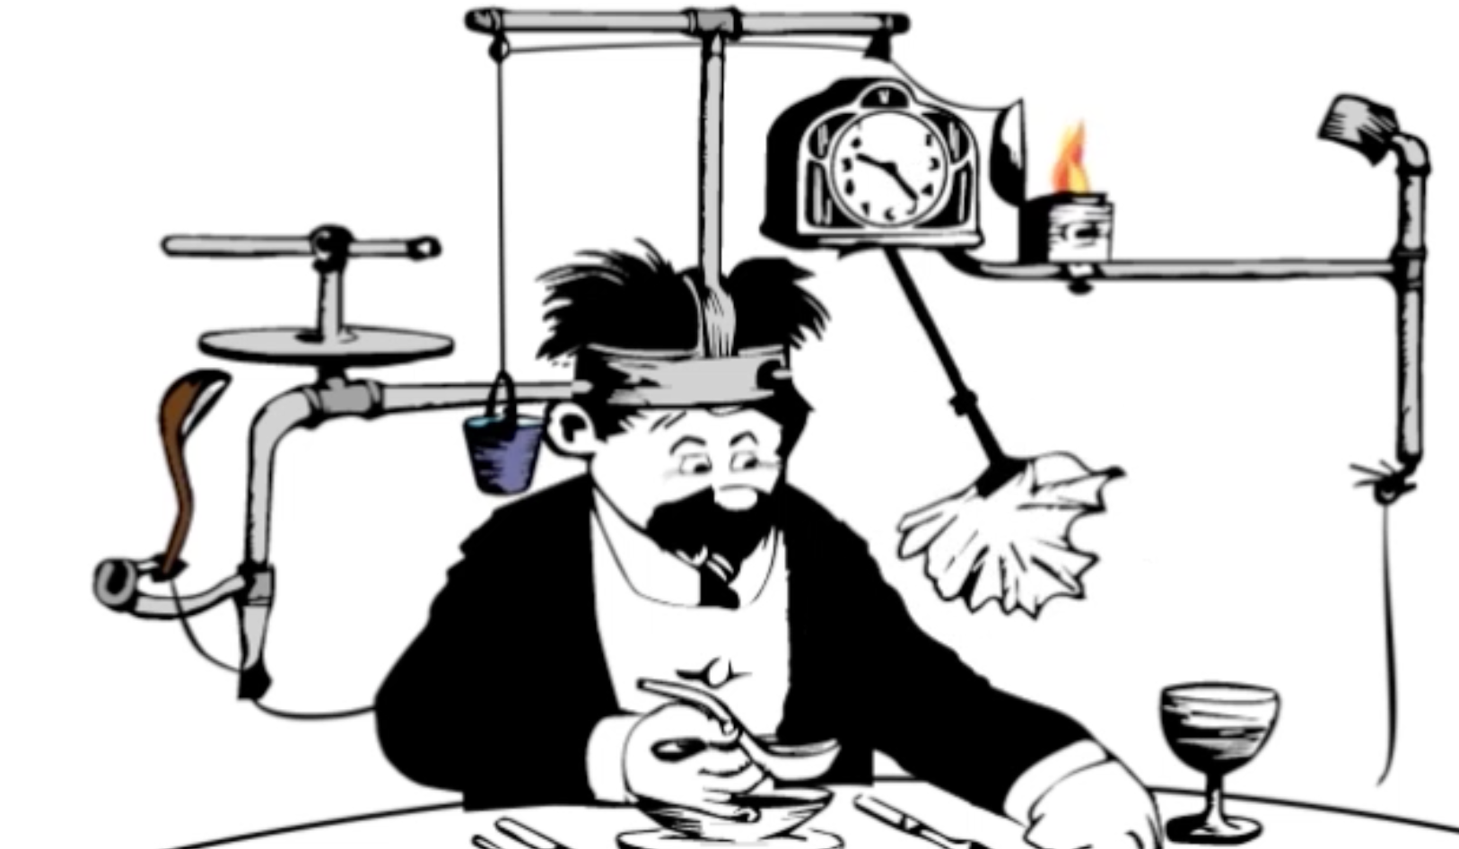
Yaroslav Yermilov Senior Software Engineer EPAM Systems yermilov17@gmail.com https://yermilov.github.io/ https://twitter.com/yermilov17 https://www.facebook.com/yaroslav.yermilov https://ua.linkedin.com/pub/yaroslav-yermilov/58/682/506
work for EPAM Systems since 2011 distributed systems, Big Data and automated testing out of office - Groovy
https://motherboard.vice.com/en_us/article/inside-rube-goldberg-machine-youtube-video-artist-joseph-herschers-bedroom-workshop

Slide 6
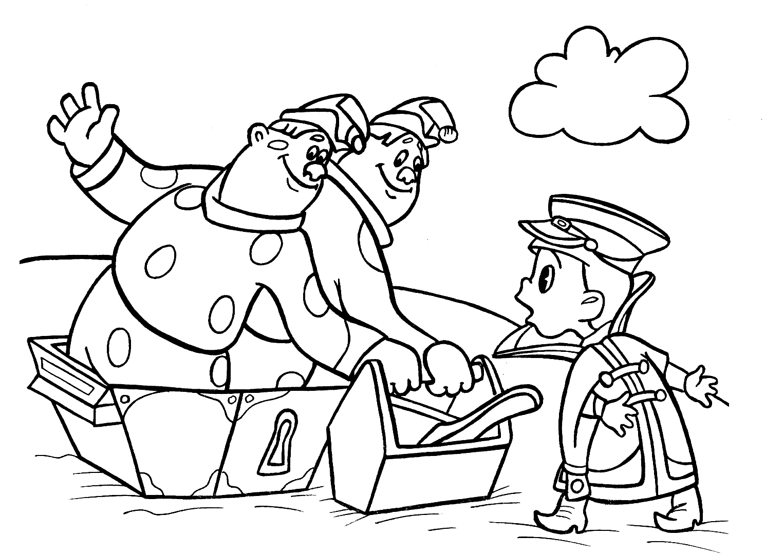
two guidelines for developing concurrent code

Slide 7
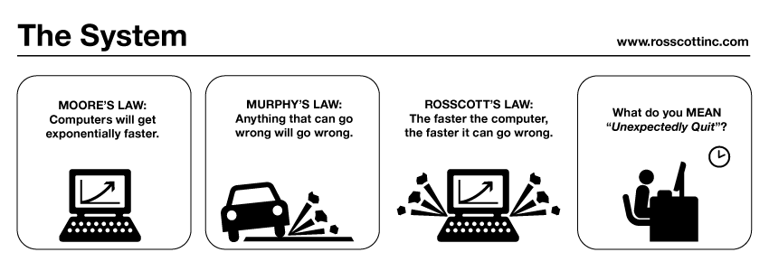

guideline #2 for developing concurrent code
public class Holder {
private int n;
public Holder(int n) { this.n = n; }
public void assertSanity() {
if (n != n) {
throw new AssertionError("Even it can go wrong!");
}
}
}
public class Initializer {
public Holder holder;
public void init() { holder = new Holder(42); }
}
public class Holder {
private int n;
public Holder(int n) { this.n = n; }
public void assertSanity() {
if (n != n) {
throw new AssertionError("Even it can go wrong!");
}
}
}
public class Initializer {
public Holder holder;
public void init() { holder = new Holder(42); }
}
MURPHY’S LAW:
Anything that can go wrong will go wrong.
Holder was not properly published!
http://www.systemcomic.com/2009/04/27/the-system-197

Slide 8
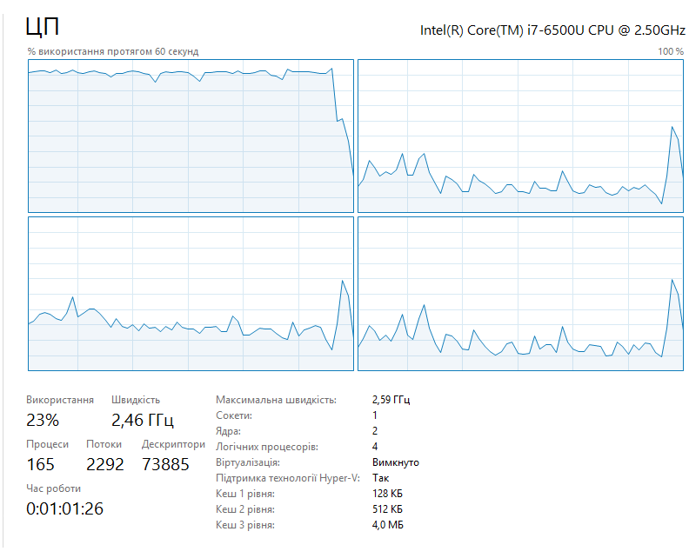
guideline #1 for developing concurrent code
MOORE’S LAW:
Computers will get exponentially faster.
your code may not
http://www.systemcomic.com/2009/04/27/the-system-197

Slide 9
two guidelines for developing concurrent code
Java toolbox

Slide 10
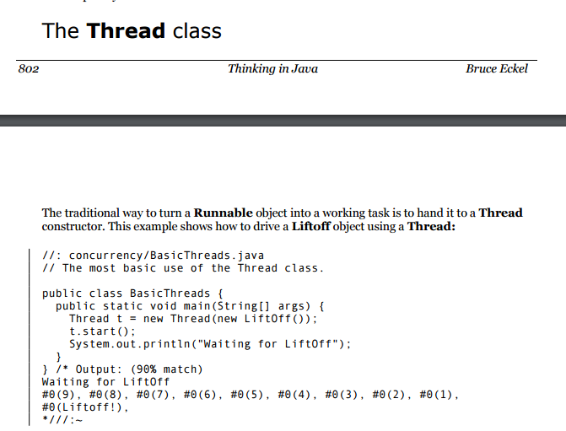

Slide 11
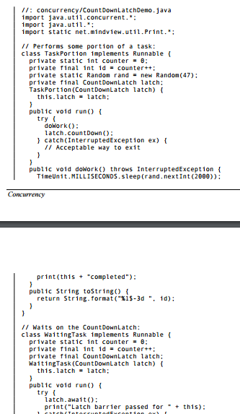
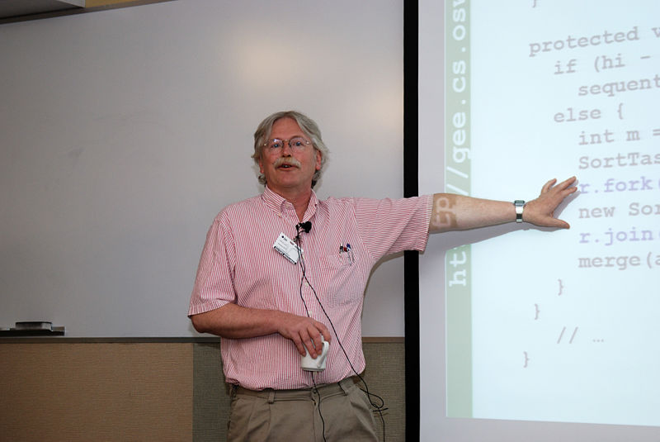
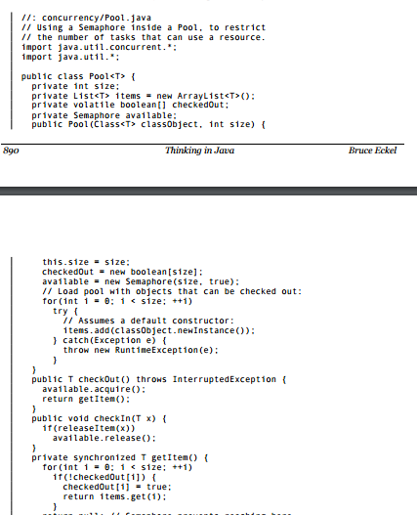
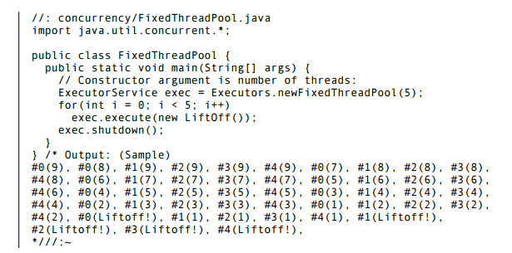
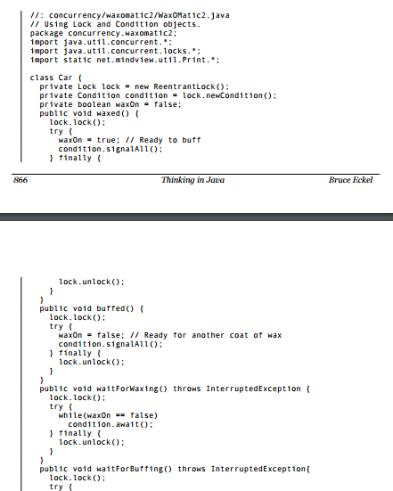
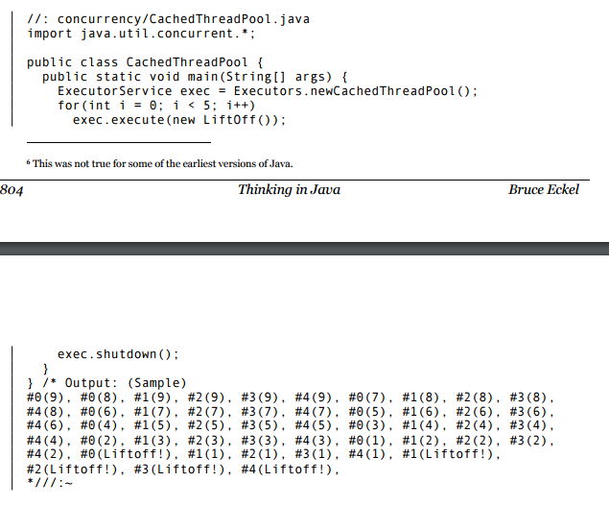
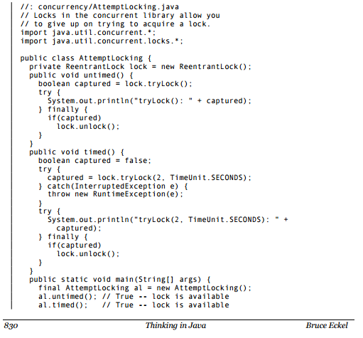
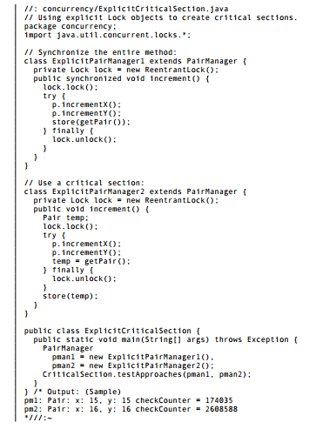
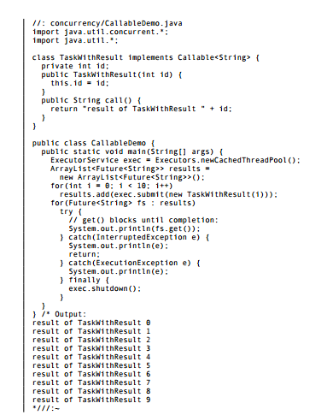
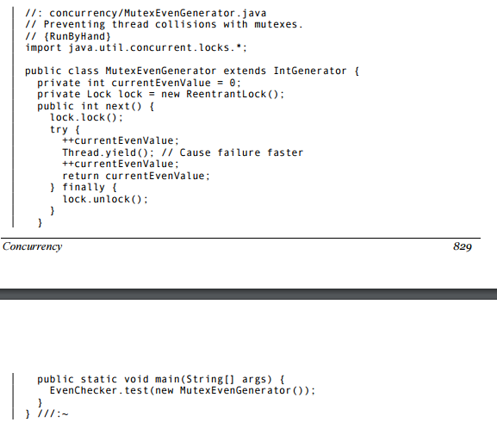
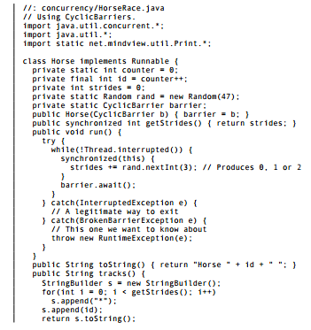
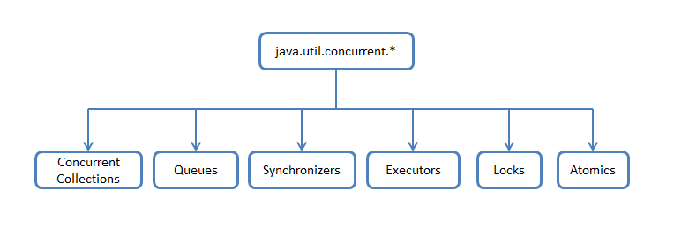
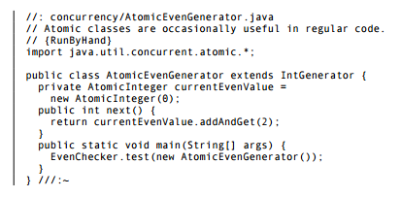
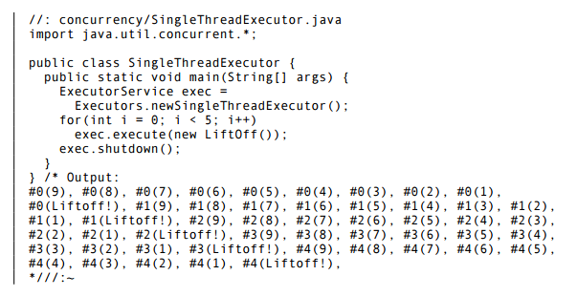

Slide 12
two guidelines for developing concurrent code
developer
Java toolbox

Slide 13
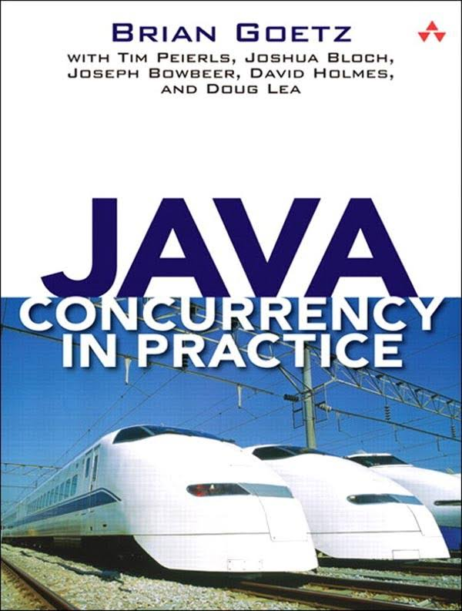
If multiple threads access the same mutable state variable without appropriate synchronization, your program is broken.
There are three ways to fix it:

Slide 14
If multiple threads access the same mutable state variable without appropriate synchronization, your program is broken.
There are three ways to fix it:
Don’t share the state variable across threads

Slide 15
If multiple threads access the same mutable state variable without appropriate synchronization, your program is broken.
There are three ways to fix it:
Don’t share the state variable across threads
Make the state variable immutable

Slide 16
If multiple threads access the same mutable state variable without appropriate synchronization, your program is broken.
There are three ways to fix it:
Don’t share the state variable across threads
Make the state variable immutable
Use synchronization whenever accessing the state variable

Slide 17
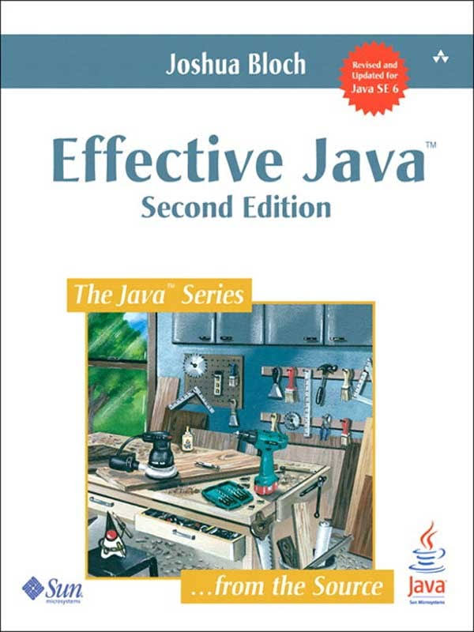
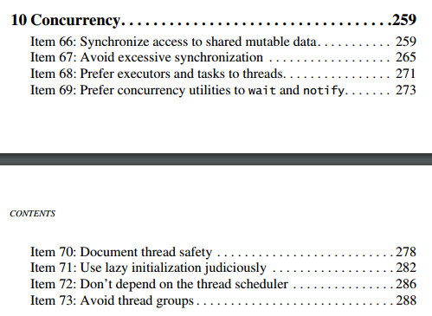

Slide 18
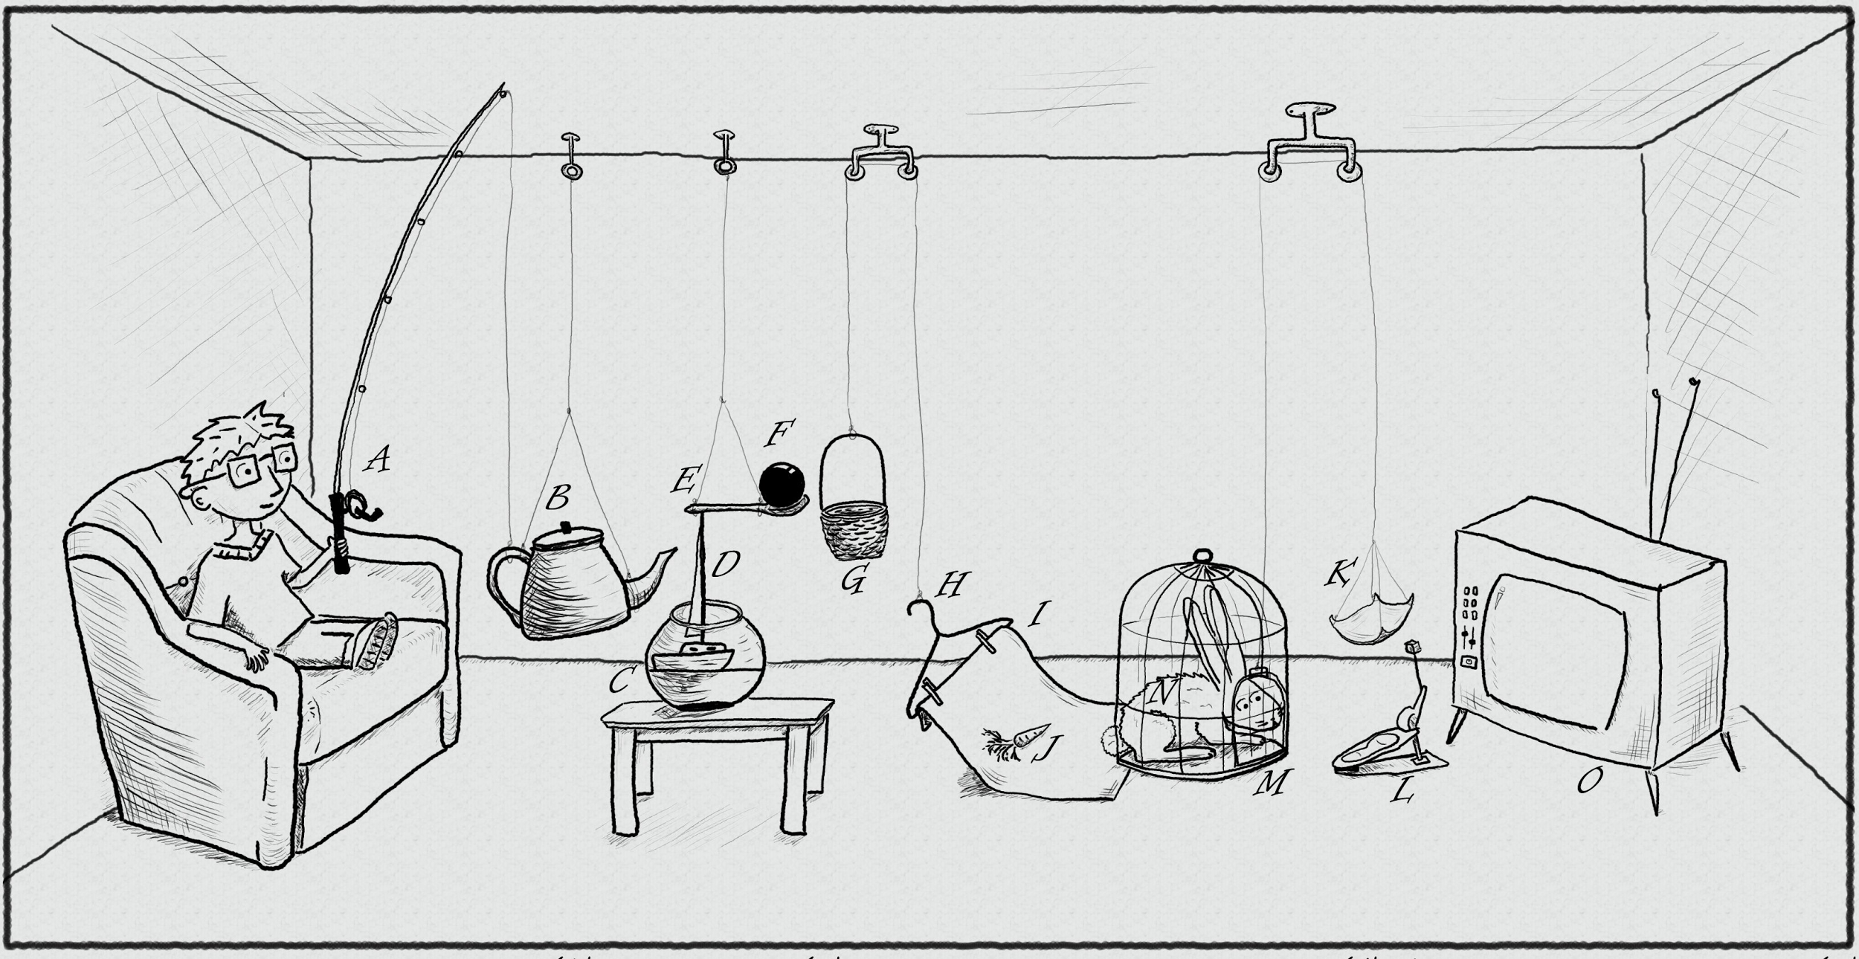
The traditional thread-based concurrency model built into Java doesn’t match well with the natural human sense for parallelism.
https://www.pinterest.com/pin/395190936024778319/

Slide 19

public class MergeSortTask<T extends Comparable<T>> extends RecursiveTask<List<T>> {
@Override
protected List<T> compute() {
if (list.size() < 2) { return list; }
if (list.size() == 2) {
if (list.get(0).compareTo(list.get(1)) != 1) {
return list;
} else {
return asList(list.get(1), list.get(0));
}
}
MergeSortTask<T> leftTask = new MergeSortTask<>(list.subList(0, list.size() / 2));
MergeSortTask<T> rightTask = new MergeSortTask<>(list.subList(list.size() / 2, list.size()));
leftTask.fork(); rightTask.fork();
List<T> left = leftTask.join();
List<T> right = rightTask.join();
return merge(left, right);
}
http://blog.takipi.com/forkjoin-framework-vs-parallel-streams-vs-executorservice-the-ultimate-benchmark/

Slide 20
public class MergeSortTask<T extends Comparable<T>> extends RecursiveTask<List<T>> {
@Override
protected List<T> compute() {
if (list.size() < 2) { return list; }
if (list.size() == 2) {
if (list.get(0).compareTo(list.get(1)) != 1) {
return list;
} else {
return asList(list.get(1), list.get(0));
}
}
MergeSortTask<T> leftTask = new MergeSortTask<>(list.subList(0, list.size() / 2));
MergeSortTask<T> rightTask = new MergeSortTask<>(list.subList(list.size() / 2, list.size()));
leftTask.fork(); rightTask.fork();
List<T> left = leftTask.join();
List<T> right = rightTask.join();
return merge(left, right);
}
http://blog.takipi.com/forkjoin-framework-vs-parallel-streams-vs-executorservice-the-ultimate-benchmark/

Slide 21
public class MergeSortTask<T extends Comparable<T>> extends RecursiveTask<List<T>> {
@Override
protected List<T> compute() {
if (list.size() < 2) { return list; }
if (list.size() == 2) {
if (list.get(0).compareTo(list.get(1)) != 1) {
return list;
} else {
return asList(list.get(1), list.get(0));
}
}
MergeSortTask<T> leftTask = new MergeSortTask<>(list.subList(0, list.size() / 2));
MergeSortTask<T> rightTask = new MergeSortTask<>(list.subList(list.size() / 2, list.size()));
leftTask.fork(); rightTask.fork();
List<T> left = leftTask.join();
List<T> right = rightTask.join();
return merge(left, right);
}
http://blog.takipi.com/forkjoin-framework-vs-parallel-streams-vs-executorservice-the-ultimate-benchmark/

Slide 22
public class MergeSortTask<T extends Comparable<T>> extends RecursiveTask<List<T>> {
@Override
protected List<T> compute() {
if (list.size() < 2) { return list; }
if (list.size() == 2) {
if (list.get(0).compareTo(list.get(1)) != 1) {
return list;
} else {
return asList(list.get(1), list.get(0));
}
}
MergeSortTask<T> leftTask = new MergeSortTask<>(list.subList(0, list.size() / 2));
MergeSortTask<T> rightTask = new MergeSortTask<>(list.subList(list.size() / 2, list.size()));
leftTask.fork(); rightTask.fork();
List<T> left = leftTask.join();
List<T> right = rightTask.join();
return merge(left, right);
}
http://blog.takipi.com/forkjoin-framework-vs-parallel-streams-vs-executorservice-the-ultimate-benchmark/

Slide 23
public class MergeSortTask<T extends Comparable<T>> extends RecursiveTask<List<T>> {
@Override
protected List<T> compute() {
if (list.size() < 2) { return list; }
if (list.size() == 2) {
if (list.get(0).compareTo(list.get(1)) != 1) {
return list;
} else {
return asList(list.get(1), list.get(0));
}
}
MergeSortTask<T> leftTask = new MergeSortTask<>(list.subList(0, list.size() / 2));
MergeSortTask<T> rightTask = new MergeSortTask<>(list.subList(list.size() / 2, list.size()));
leftTask.fork(); rightTask.fork();
List<T> left = leftTask.join();
List<T> right = rightTask.join();
return merge(left, right);
}
http://blog.takipi.com/forkjoin-framework-vs-parallel-streams-vs-executorservice-the-ultimate-benchmark/

Slide 24

.parallel()
Optional<Status> mostPopularTweet = tweets.stream()
.filter(tweet -> tweet.getText().toLowerCase().contains(topic.toLowerCase()))
.filter(tweet -> !tweet.isRetweet())
.max(comparingInt(tweet -> tweet.getFavoriteCount() + tweet.getRetweetCount()));

Slide 25
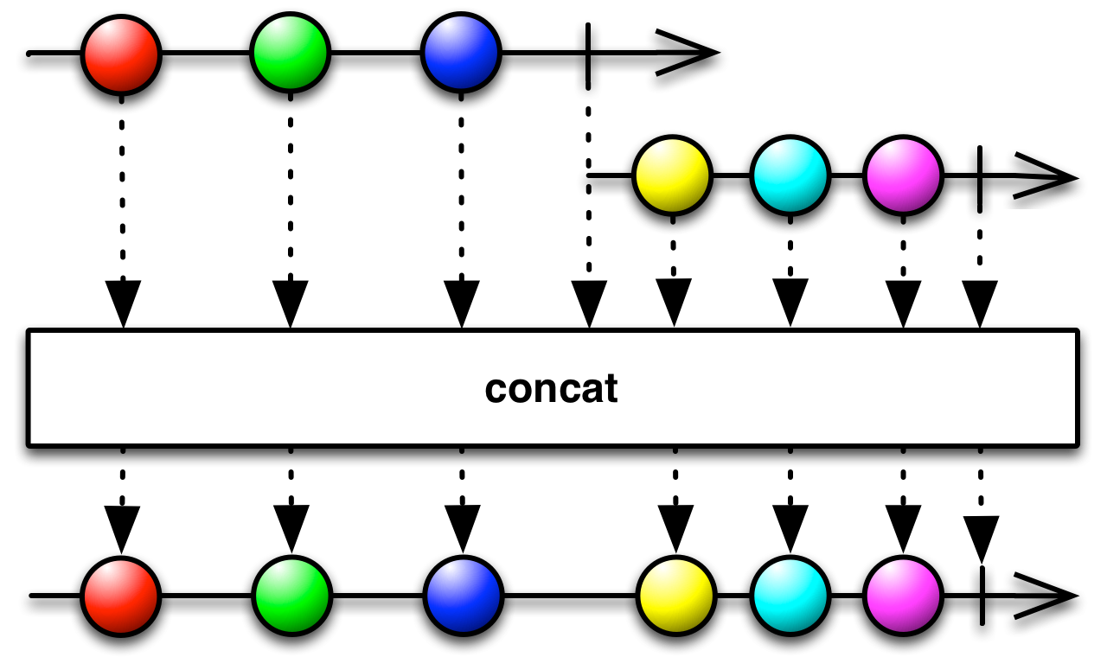
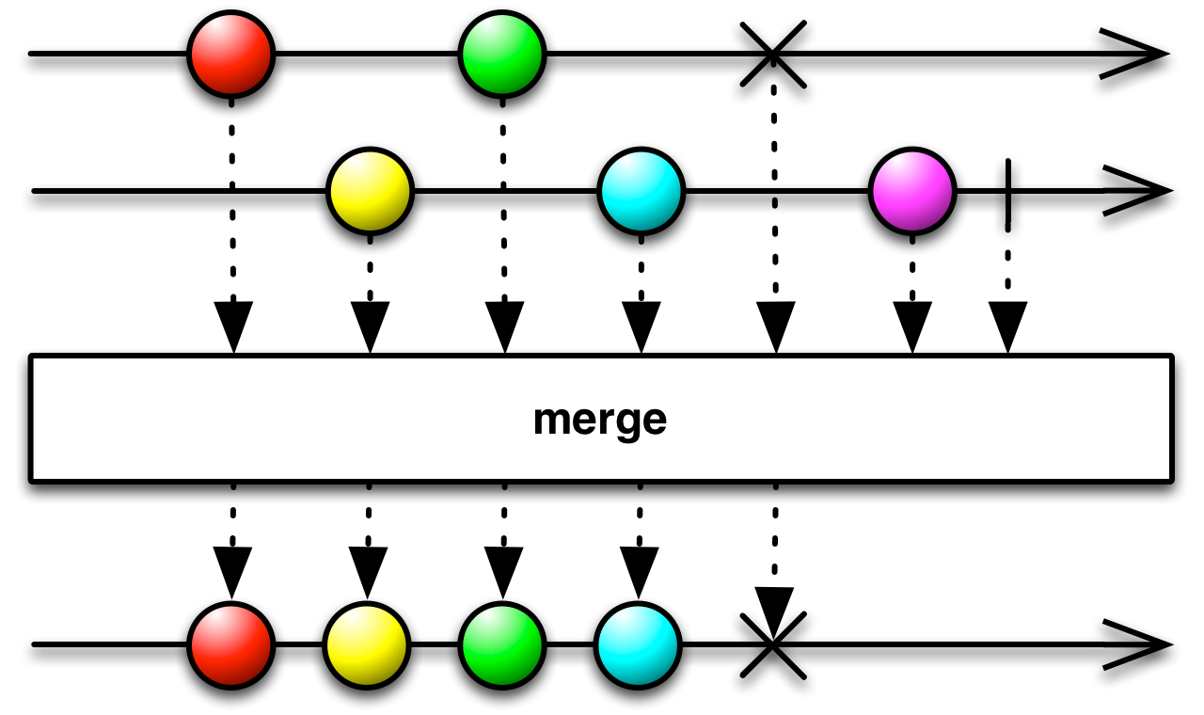
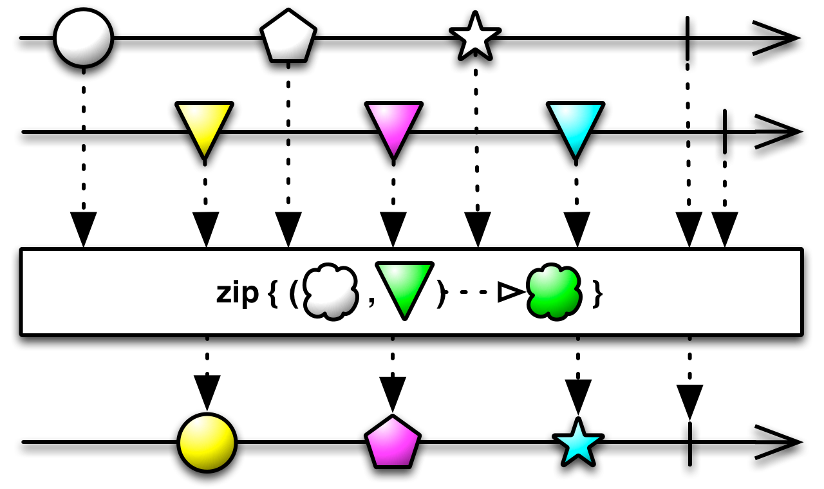
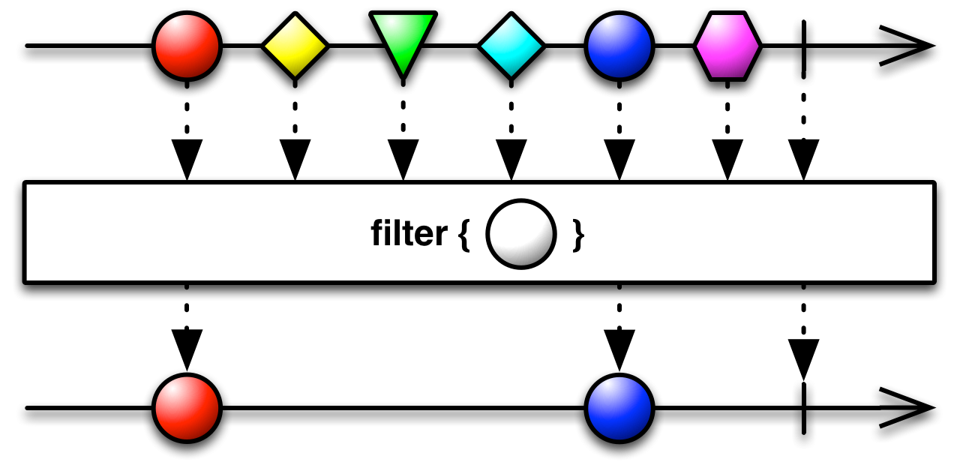
http://reactivex.io/RxJava/2.x/javadoc/io/reactivex/Flowable.html

Slide 26
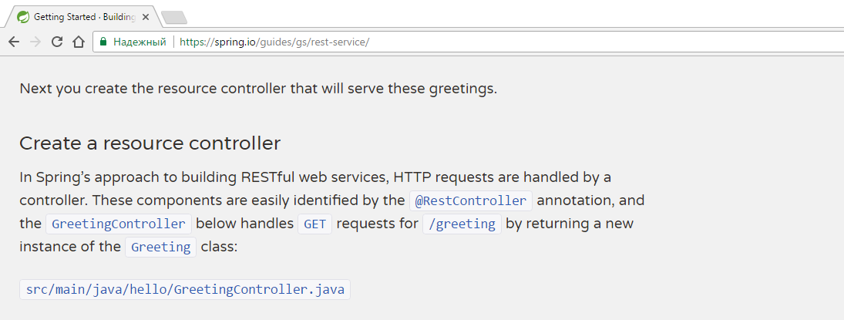
@RestController
public class GreetingController {
private static final String template = "Hello, %s!";
private final AtomicLong counter = new AtomicLong();
@RequestMapping("/greeting")
public Greeting greeting(@RequestParam(value="name", defaultValue="World") String name) {
return new Greeting(counter.incrementAndGet(), String.format(template, name));
}
}

Slide 27
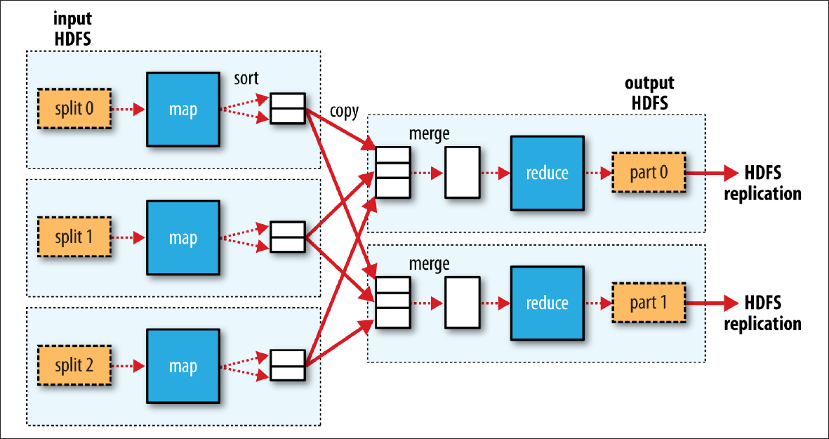

Slide 28



Slide 29
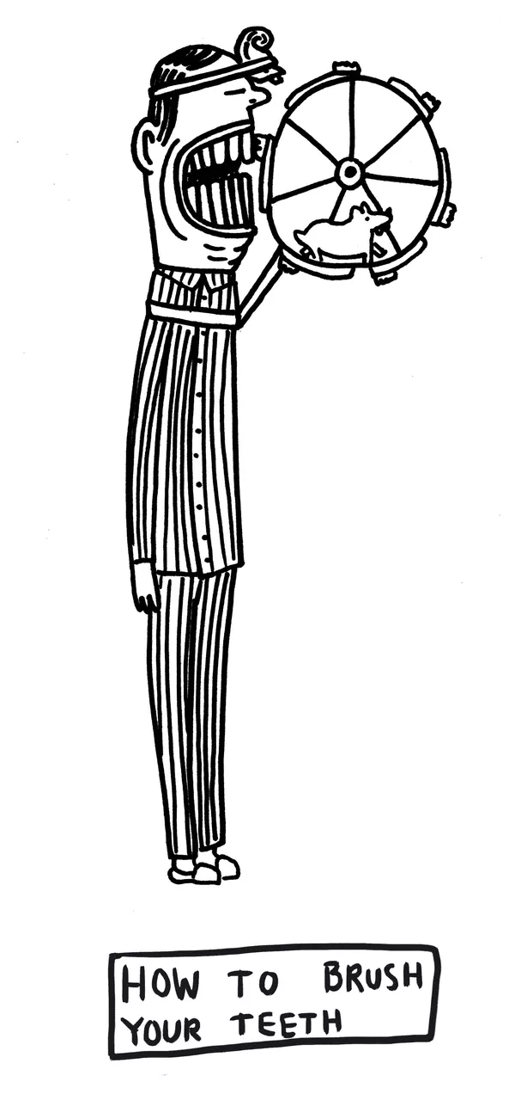
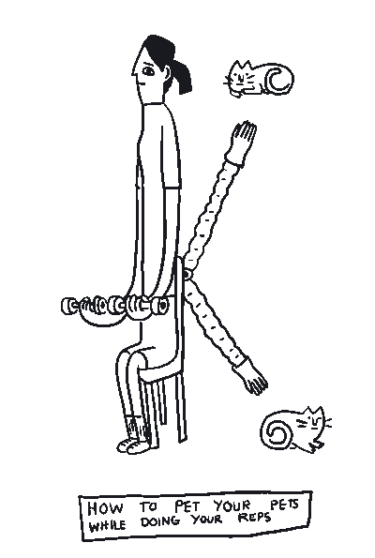
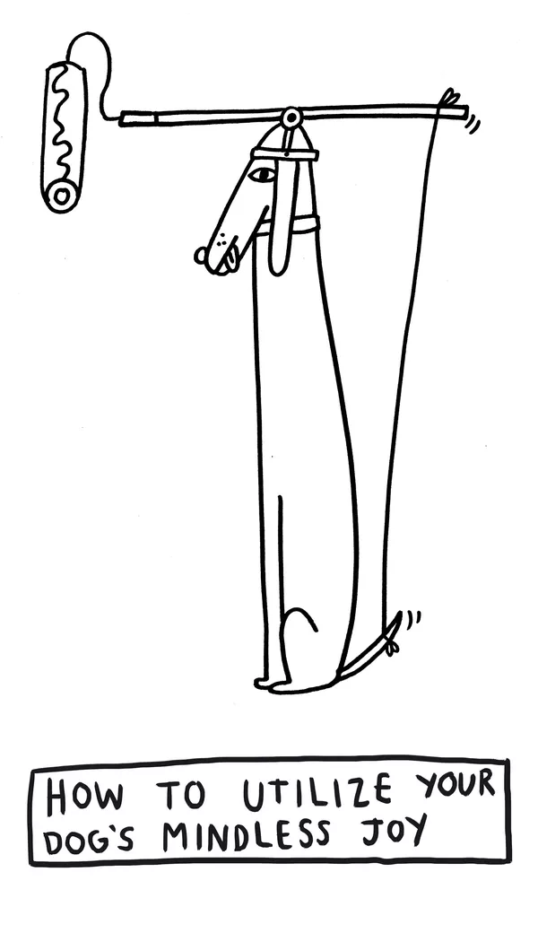
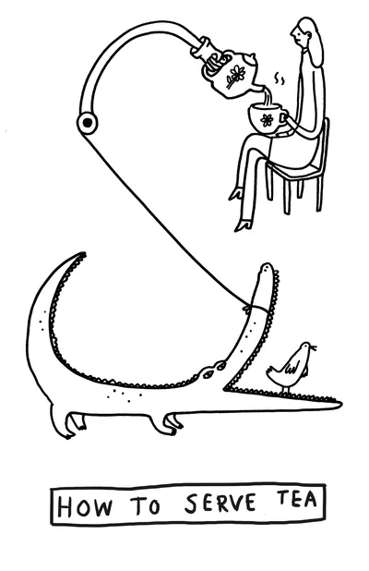
GPars
data parallelism
map/reduce
fork/join
asynchronous execution
actors
agents
dataflows
remote execution
Communicating Sequential Processes
Software Transactional Memory
http://www.theverge.com/2015/4/22/8381963/rube-goldberg-machine-contest-history-ideas

Slide 30
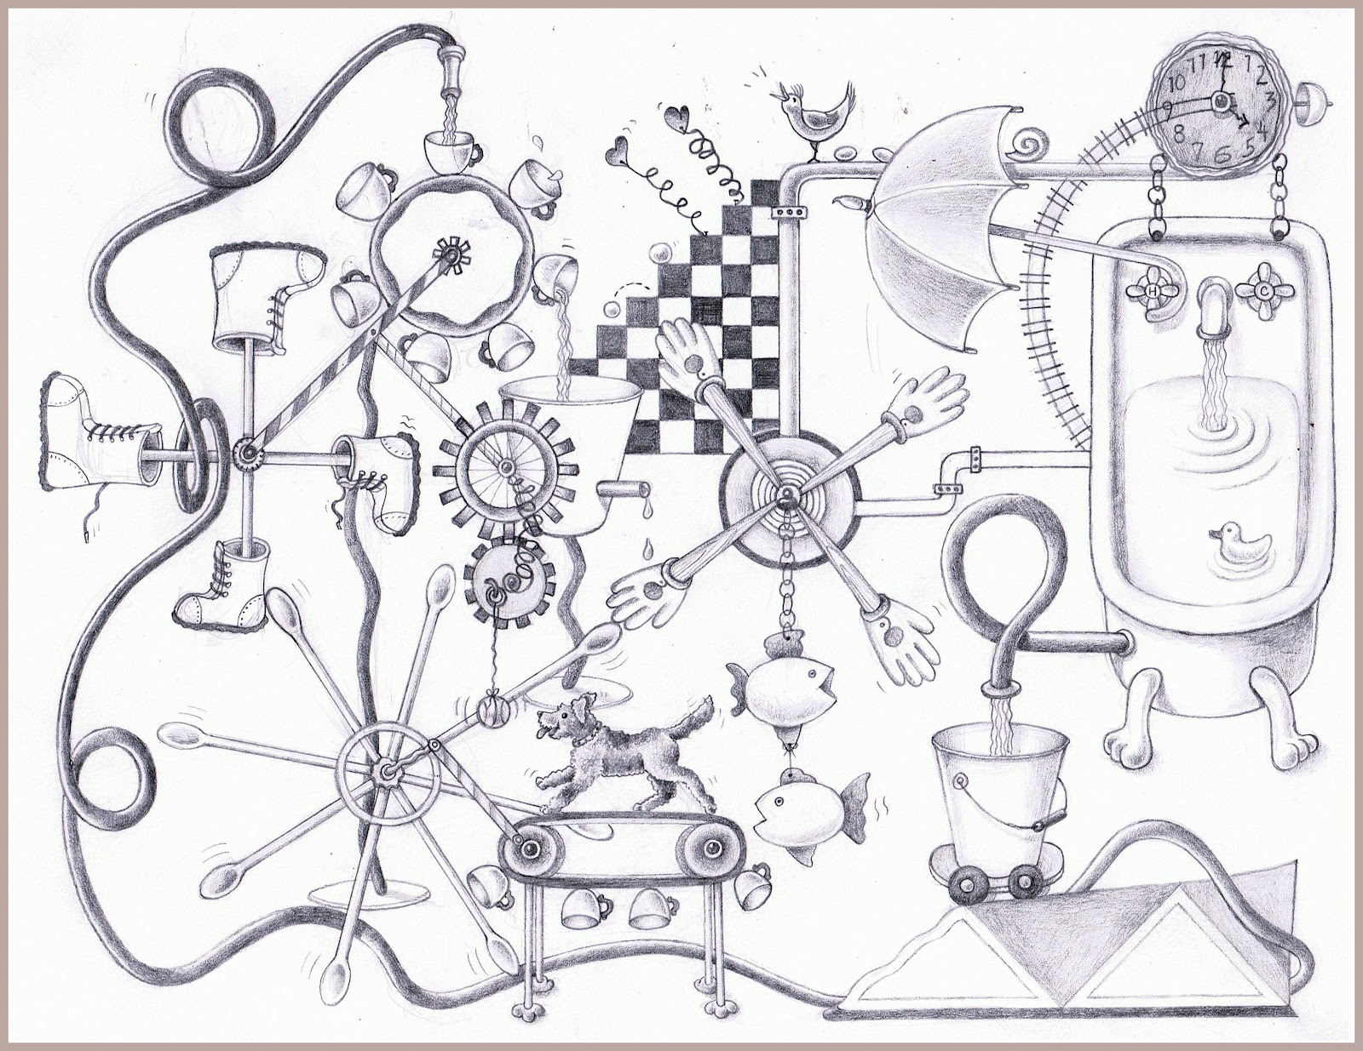

DEMO
goo.gl/PZNNGY
https://www.pinterest.com/pin/527554543837493577/

Slide 31
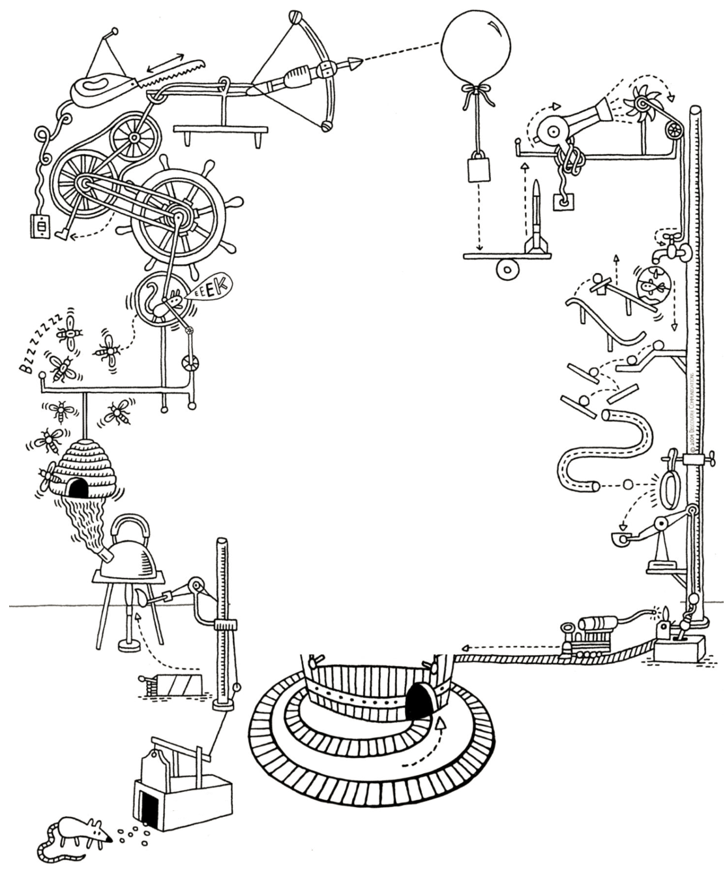
JAVA
OR
GROOVY?
http://forevercuriousmuseum.org/events/rube-goldberg-machine-summer-camp-july-28-29-30-2015/

Slide 32
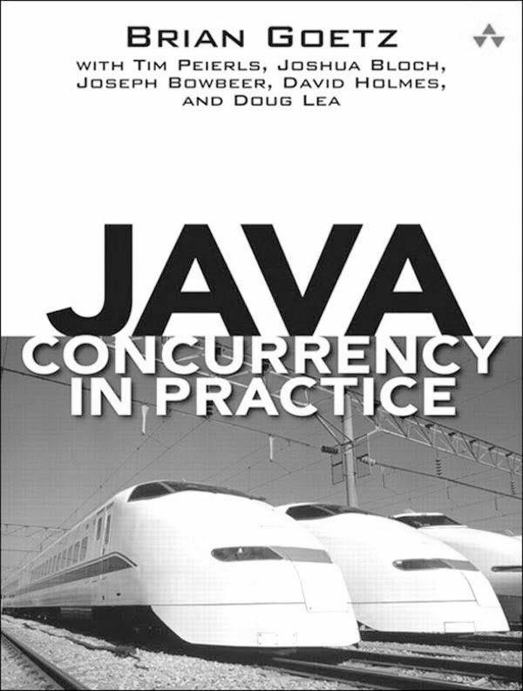
If multiple threads access the same mutable state variable without appropriate synchronization, your program is broken.
There are three ways to fix it:
Don’t share the state variable across threads
Make the state variable immutable
Use synchronization whenever accessing the state variable

Slide 33
public final class ImmutableJavaPerson {
private final String name;
private final Collection<String> tweets;
public ImmutableJavaPerson(String name, Collection<String> tweets) {
this.name = name;
this.tweets = new ArrayList<>(tweets);
}
public String getName() {
return name;
}
public Collection<String> getTweets() {
return unmodifiableCollection(tweets);
}
@Override
public boolean equals(Object o) {
if (this == o) return true;
if (o == null || getClass() != o.getClass()) return false;
ImmutableJavaPerson that = (ImmutableJavaPerson) o;
if (name != null ? !name.equals(that.name) : that.name != null) return false;
return tweets != null ? tweets.equals(that.tweets) : that.tweets == null;
}
@Override
public int hashCode() {
int result = name != null ? name.hashCode() : 0;
result = 31 * result + (tweets != null ? tweets.hashCode() : 0);
return result;
}
}

Slide 34
@Override
public boolean equals(Object o) {
if (this == o) return true;
if (o == null || getClass() != o.getClass()) return false;
ImmutableJavaPerson that = (ImmutableJavaPerson) o;
if (name != null ? !name.equals(that.name) : that.name != null) return false;
return tweets != null ? tweets.equals(that.tweets) : that.tweets == null;
}
@Override
public int hashCode() {
int result = name != null ? name.hashCode() : 0;
result = 31 * result + (tweets != null ? tweets.hashCode() : 0);
return result;
}
}

Slide 35

@Immutable class ImmutableGroovyPerson {
String name
Collection<String> tweets
}

Slide 36

@Immutable class ImmutableGroovyPerson {
String name
Collection<String> tweets
}

Slide 37
class SynchronizedCounter {
int atomicCounter
int counter
@Synchronized
int incrementAndGet() {
atomicCounter = atomicCounter + 1
return atomicCounter
}
@WithReadLock
int value() {
counter
}
@WithWriteLock
void increment() {
counter = counter + 1
}
}

Slide 38
def thread1 = Thread.start {
println "Hello from ${Thread.currentThread().name}"
}
def thread2 = Thread.startDaemon {
println "Hello from ${Thread.currentThread().name}"
}
[ thread1, thread2 ]*.join()

Slide 39
def process = (['git', 'status']).execute([], new File('.'))
def processOutput = new StringWriter()
process.consumeProcessOutput processOutput, processOutput
process.waitFor()
println processOutput.toString().trim()

Slide 40
def config = new CompilerConfiguration()
config.addCompilationCustomizers(new ASTTransformationCustomizer(ThreadInterrupt))
def binding = new Binding(i:0)
def shell = new GroovyShell(binding,config)
def t = Thread.start {
shell.evaluate(userCode)
}
t.join(1000)
if (t.alive) {
t.interrupt()
}
@TimedInterrupt(value=1, unit=TimeUnit.SECONDS)
class FibCalculator {
def fib(int n) {
n < 2 ? n : fib(n - 1) + fib(n - 2)
}
}
@ConditionalInterrupt({ Quotas.disallow('user') })
class UserService {
void longRunningRequest() { ... }
}

Slide 41
"Hello from ${Thread.currentThread().name}"
'''Multi-line
strings'''
def numbers = [ 1, 2, 3 ]
def colors = [ red: '#ff0000', green: '#00ff00', blue: '#0000ff' ]
carNames = car*.name
Clousure sum = { a, b -> a + b }
Clouse increment = sum.curry(1)
name = user?.name
displayName = user.name ?: 'unknown'
assert new String('text') == new String('text')
assert (2 <=> 5) == -1
Object str1 = 'text'
def str2 = str1
assert str1.length() == str2.length()
def sneakyThrow() { throw new IOException("i don't care") }
@IgnoreIf({ os.linux || jdk.version == 8 })

Slide 42
def rows = Sql.newInstance(url, user, password, driver).rows "SELECT * FROM table"
(0..<5).collect { it % 2 == 0 }
println list.find { it > 7 }
if (4 in nums) println 'yes'
println persons.max({ person -> person.age })
5.times { println 'hello!' }
println list[0..2]
def json = new JsonSlurper().parseText(jsonText)
json.clients[3].location.country.code
def xml = new XmlSlurper().parseText(xmlText)
xml.clients[3].location.country.@code
xmlBuilder.root(attribute: 28) {
elem1('hello')
elem2('xml')
}
new File('poem.txt').eachLine { line ->
println line
}
def increment(int number, int delta = 0) { ... }
def connectJdbc(Map params) { ... }
connectJdbc(url: 'jdbc://', driver: 'generic', username: 'admin', password: 'admin')

Slide 43
@Grab(group='org.springframework', module='spring-orm', version='4.3.8.RELEASE')
import org.springframework.jdbc.core.JdbcTemplate
@TypeChecked
@CompileStatic
@Canonical
@InheritConstructors
@Lazy
@Sortable
@Builder
@Delegate
@Memoized
@Singleton
@Log
class MetaProgramming {
def methodMissing(String methodName, def methodArgs) { ... }
}
Number.metaClass.doubleIt = { -> delegate * 2 }
ReturnStatement returnStatement = macro { return "42" }
class MyNumber {
MyNumber plus(MyNumber other) { ... }
}
trait DatabaseTest { ... }
please show the square_root of 100
new GroovyShell(variables).evaluate 'println persons.sort { person -> person.name }'

Slide 44
min

Slide 45
min

Slide 46
min

Slide 47
min

Slide 48
min

Slide 49
min
min
min
min

Slide 50
Optional<Status> mostPopularTweet = tweets.stream()
.parallel()
.filter(tweet -> tweet.getText().toLowerCase().contains(topic.toLowerCase()))
.filter(tweet -> !tweet.isRetweet())
.max(comparingInt(tweet -> tweet.getFavoriteCount() + tweet.getRetweetCount()));

Slide 51
shapes.stream()

Slide 52
Optional<Shape> minBlueCircle = shapes.stream()
.filter(shape -> shape.getType() == CIRCLE)

Slide 53
Optional<Shape> minBlueCircle = shapes.stream()
.filter(shape -> shape.getType() == CIRCLE)
.filter(shape -> shape.getColor() == BLUE)

Slide 54
Optional<Shape> minBlueCircle = shapes.stream()
.filter(shape -> shape.getType() == CIRCLE)
.filter(shape -> shape.getColor() == BLUE)
.min(comparingInt(shape -> shape.getSize()));

Slide 55
min
Optional<Shape> minBlueCircle = shapes.stream()
.parallel()
.filter(shape -> shape.getType() == CIRCLE)
.filter(shape -> shape.getColor() == BLUE)
.min(comparingInt(shape -> shape.getSize()));
.filter(shape -> shape.getType() == CIRCLE)
.filter(shape -> shape.getColor() == BLUE)
.min(comparingInt(shape -> shape.getSize()));

Slide 56
shapes

Slide 57
Shape minBlueCircle = shapes
.findAll({ shape -> shape.type == CIRCLE })

Slide 58
Shape minBlueCircle = shapes
.findAll({ shape -> shape.type == CIRCLE })
.findAll({ shape -> shape.color == BLUE })

Slide 59
Shape minBlueCircle = shapes
.findAll({ shape -> shape.type == CIRCLE })
.findAll({ shape -> shape.color == BLUE })
.min({ shape -> shape.size })

Slide 60
ParallelEnhancer.enhanceInstance shapes
Shape minBlueCircle = shapes
.findAllParallel({ shape -> shape.type == CIRCLE })
.findAllParallel({ shape -> shape.color == BLUE })
.minParallel({ shape -> shape.size })

Slide 61
min
ParallelEnhancer.enhanceInstance shapes
shapes.makeConcurrent()
Shape minBlueCircle = shapes
.findAll({ shape -> shape.type == CIRCLE })
.findAll({ shape -> shape.color == BLUE })
.min({ shape -> shape.size })
.findAll({ shape ->
shape.type == CIRCLE
})

Slide 62
min
ParallelEnhancer.enhanceInstance shapes
shapes.makeConcurrent()
Shape minBlueCircle = shapes
.findAll({ shape -> shape.type == CIRCLE })
.findAll({ shape -> shape.color == BLUE })
.min({ shape -> shape.size })
.findAll({ shape ->
shape.color == BLUE
})

Slide 63
min
ParallelEnhancer.enhanceInstance shapes
shapes.makeConcurrent()
Shape minBlueCircle = shapes
.findAll({ shape -> shape.type == CIRCLE })
.findAll({ shape -> shape.color == BLUE })
.min({ shape -> shape.size })
.min({ shape -> shape.size
})

Slide 64
Shape minBlueCircle = shapes
.findAll({ shape -> shape.type == CIRCLE })
.findAll({ shape -> shape.color == BLUE })
.min({ shape -> shape.size })

Slide 65
min
withPool {
Shape minBlueCircle = shapes.parallel
.filter({ shape -> shape.type == CIRCLE })
.filter({ shape -> shape.color == BLUE })
.min({ shape -> shape.size })
}
.filter({ shape -> shape.type == CIRCLE })
.filter({ shape -> shape.color == BLUE })
.min({ shape -> shape.size })

Slide 66
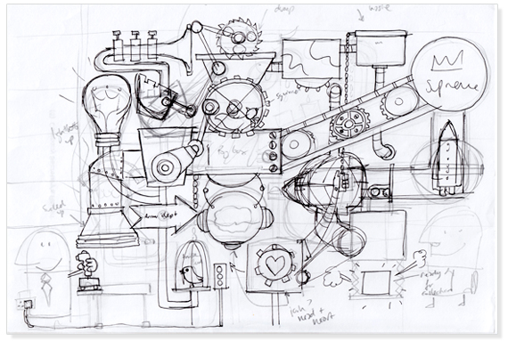
withPool
https://discoveryartjoy.wordpress.com/page/2/

Slide 67
withPool {
}

Slide 68
GParsPool.withPool {
}

Slide 69
GParsPool.withPool { ForkJoinPool pool ->
}

Slide 70
GParsPool.withExistingPool(pool) {
}

Slide 71
GParsExecutorsPool.withPool { ExecutorService executor ->
}

Slide 72
GParsPool.withPool { ForkJoinPool pool ->
}

Slide 73
GParsPool.withPool(numberOfThreads, exceptionHandler) { ForkJoinPool pool ->
}
Runtime.getRuntime().availableProcessors() + 1

Slide 74
withPool {
}
Shape minBlueCircle = shapes
.findAllParallel({ shape -> shape.type == CIRCLE })
.findAllParallel({ shape -> shape.color == BLUE })
.minParallel({ shape -> shape.size })
shapes.makeConcurrent()
Shape minBlueCircle = shapes
.findAll({ shape -> shape.type == CIRCLE })
.findAll({ shape -> shape.color == BLUE })
.min({ shape -> shape.size })
Shape minBlueCircle = shapes.parallel
.filter({ shape -> shape.type == CIRCLE })
.filter({ shape -> shape.color == BLUE })
.min({ shape -> shape.size })

Slide 75
withPool {
}

Slide 76
withPool {
List latestTweets = twitter.fetchLatestTweets()
println 'Done:'
println latestTweets
}

Slide 77
withPool {
Future latestTweets = executeAsync({ twitter.fetchLatestTweets() })
println 'Loading...'
println latestTweets.get()
}

Slide 78
withPool {
Future latestTweets = twitter.&fetchLatestTweets.callAsync()
println 'Loading...'
println latestTweets.get()
}

Slide 79
withPool {
Closure fetchLatestTweetsAsync = twitter.&fetchLatestTweets.async()
Future latestTweets = fetchLatestTweetsAsync()
println 'Loading...'
println latestTweets.get()
}

Slide 80
withPool {
Closure fetchLatestTweetsAsync = twitter.&fetchLatestTweets.async()
Future latestTweets = fetchLatestTweetsAsync()
Closure extractKeywordsAsync = keywords.&extractKeywords.async()
println 'Loading tweets...'
Future keywords = extractKeywordsAsync(latestTweets.get())
println 'Extracting keywords...'
println keywords.get()
}

Slide 81
withPool {
Closure fetchLatestTweetsAsync = twitter.&fetchLatestTweets.asyncFun()
Promise latestTweets = fetchLatestTweetsAsync()
Closure extractKeywordsAsync = keywords.&extractKeywords.asyncFun()
Promise keywords = extractKeywordsAsync(latestTweets)
println 'Loading tweets and extracting keywords...'
println keywords.get()
}

Slide 82
withPool {
Closure fetchLatestTweetsAsync = twitter.&fetchLatestTweets.asyncFun()
Promise latestTweets = fetchLatestTweetsAsync()
Closure extractKeywordsAsync = keywords.&extractKeywords.asyncFun()
Promise keywords = extractKeywordsAsync(latestTweets)
keywords.whenBound {
println it
}
println 'Loading tweets and extracting keywords...'
}

Slide 83
withPool {
Closure fetchAsync = twitter.&fetchLatestTweets.asyncFun()
Closure watsonsExtractKeywords = watsons.&extractKeywords.curry(fetchAsync())
Closure googleExtractKeywords = google.&extractKeywords.curry(fetchAsync())
List keywords = watsonsExtractKeywords()
println keywords
}

Slide 84
withPool {
Closure fetchAsync = twitter.&fetchLatestTweets.asyncFun()
Closure watsonsExtractKeywords = watsons.&extractKeywords.curry(fetchAsync())
Closure googleExtractKeywords = google.&extractKeywords.curry(fetchAsync())
List keywords = googleExtractKeywords()
println keywords
}

Slide 85
withPool {
Closure fetchAsync = twitter.&fetchLatestTweets.asyncFun()
Closure watsonsExtractKeywords = watsons.&extractKeywords.curry(fetchAsync())
Closure googleExtractKeywords = google.&extractKeywords.curry(fetchAsync())
List keywords = speculate( watsonsExtractKeywords(), googleExtractKeywords() )
println keywords
}

Slide 86
withPool {
Closure fetchAsync = twitter.&fetchLatestTweets.asyncFun()
Closure watsonsExtractKeywords = watsons.&extractKeywords.curry(fetchAsync())
Closure googleExtractKeywords = google.&extractKeywords.curry(fetchAsync())
List keywords = speculate( watsonsExtractKeywords(), googleExtractKeywords() )
println keywords
}

Slide 87
withPool {
List latestTweets = twitter.fetchLatestTweets()
Closure watsonsExtractKeywords = watsons.&extractKeywords.curry(latestTweets)
Closure googleExtractKeywords = google.&extractKeywords.curry(latestTweets)
List keywords = speculate( watsonsExtractKeywords(), googleExtractKeywords() )
println keywords
}

Slide 88
withPool {
Closure fetchWithCache = twitter.&fetchLatestTweets.gmemoize()
Closure watsonsExtractKeywords = watsons.&extractKeywords.curry(fetchWithCache())
Closure googleExtractKeywords = google.&extractKeywords.curry(fetchWithCache())
List keywords = speculate( watsonsExtractKeywords(), googleExtractKeywords() )
println keywords
}

Slide 89
withPool {
runForkJoin(list) { list ->
if (list.size() < 2) { return list }
if (list.size() == 2) {
if (list[0] <= list[1]) {
return list
} else {
return list[-1..0]
}
}
int middleIndex = list.size() / 2
forkOffChild list[0..<middleIndex]
forkOffChild list[middleIndex..<list.size()]
return merge(*childrenResults)
}
}

Slide 90
withPool(lambdaToClosure(() -> {
}));

Slide 91
withPool(lambdaToClosure(() -> {
Future result = executeAsync (
lambdaToClosure(() -> { return twitter.fetchLatestTweets(); })
).get(0);
final List tweets = (List) result.get();
List keywords = speculate (
lambdaToClosure(() -> { return watsons.extractKeywords(tweets); }),
lambdaToClosure(() -> { return google.extractKeywords(tweets); })
);
return keywords;
}));

Slide 92
withPool(lambdaToClosure(() -> {
Future result = executeAsync (
lambdaToClosure(() -> { return twitter.fetchLatestTweets(); })
).get(0);
final List tweets = (List) result.get();
List keywords = speculate (
lambdaToClosure(() -> { return watsons.extractKeywords(tweets); }),
lambdaToClosure(() -> { return google.extractKeywords(tweets); })
);
return keywords;
}));

Slide 93
withPool {
Shape minBlueCircle = shapes
.findAllParallel({ shape -> shape.type == CIRCLE })
.findAllParallel({ shape -> shape.color == BLUE })
.minParallel({ shape -> shape.size })
}

Slide 94
withPool {
List<Shape> blueCircles = []
shapes.findAllParallel({ shape -> shape.type == CIRCLE })
.findAllParallel({ shape -> shape.color == BLUE })
.eachParallel({ shape -> blueCircles.add(shape) })
}
If multiple threads access the same mutable state variable without appropriate synchronization, your program is broken.

Slide 95
Thread #1
Thread #2
synchronized
blueCircles.add(shape)
blueCircles.add(shape)
blueCircles.add(shape)
blueCircles.add(shape)
blueCircles.add(shape)
blueCircles.add(shape)

Slide 96
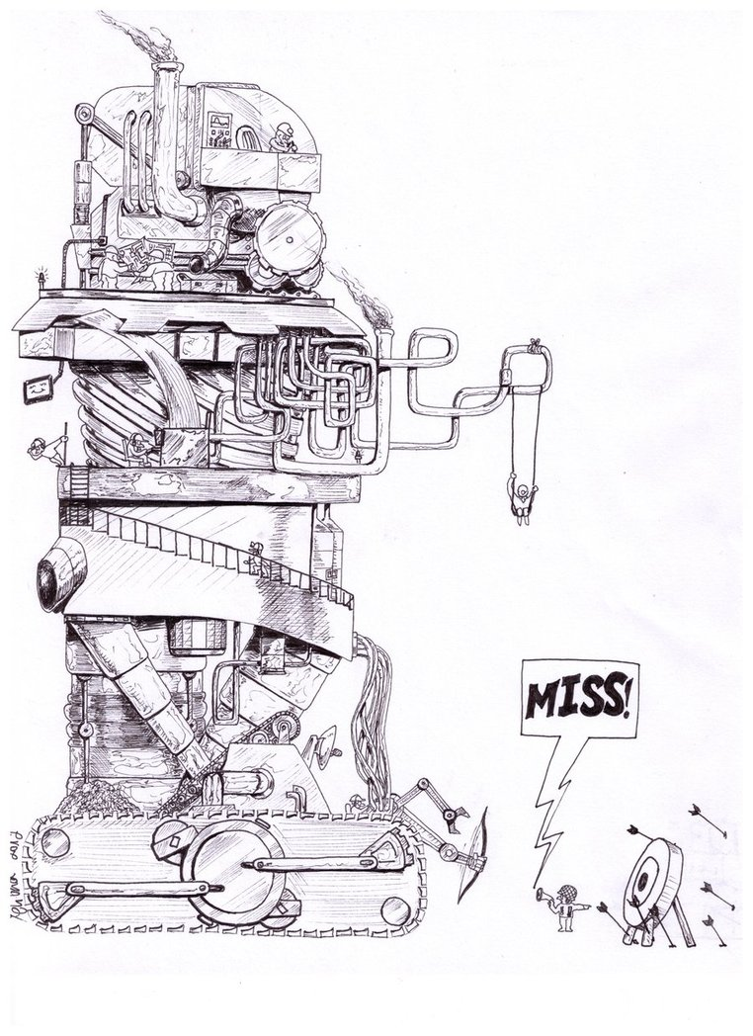
AGENTS
http://www.keywordsuggests.com/DT5zG9YMrnEK707aqUa2IhkNs5vUwu3mV6WrrLHR0soHddyR42EFvbEkYg9kaqswD%7CyremGnEFLO%7CzJXdp0SMQ/

Slide 97
withPool {
def blueShapesGuard = new Agent<List<Shape>>()
blueShapesGuard { updateValue [] }
shapes.findAllParallel({ shape -> shape.type == CIRCLE })
.findAllParallel({ shape -> shape.color == BLUE })
.eachParallel({ shape -> blueShapesGuard { it.add(shape) } })
}

Slide 98
Thread #1
Thread #2
Agent
blueCircles.add(shape)
blueCircles.add(shape)
blueCircles.add(shape)
blueCircles.add(shape)
blueCircles.add(shape)
blueCircles.add(shape)

Slide 99
withPool {
def blueShapesGuard = new Agent<Shape>()
blueShapesGuard { updateValue [] }
shapes.findAllParallel({ shape -> shape.type == CIRCLE })
.findAllParallel({ shape -> shape.color == BLUE })
.eachParallel({ shape -> blueShapesGuard { it.add(shape) } })
}
blueShapesGuard.addListener { oldValue, newValue -> … }
blueShapesGuard.addValidator { oldValue, newValue -> … }
println blueShapesGuard.val
blueShapesGuard.valAsync { println it }

Slide 100
final Agent<List<Shape>> blueShapesGuard = new Agent<>();
blueShapesGuard.send(new ArrayList<>());
blueShapesGuard.send(new MessagingRunnable<List<Shape>>() {
@Override
protected void doRun(List<Shape> value) {
value.add(shape);
}
});
blueShapesGuard.valAsync(new MessagingRunnable<List<Shape>>() {
@Override
protected void doRun(List<Shape> value) {
System.out.println(value);
}
});

Slide 101
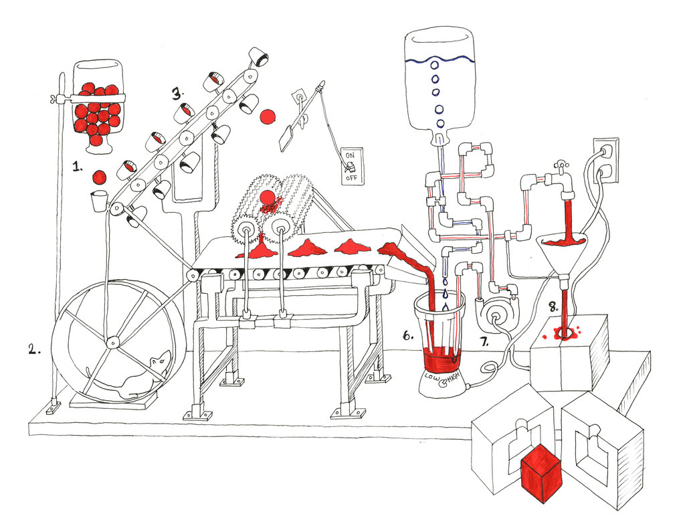
ACTORS
http://tommyboy5000.deviantart.com/art/Rube-Goldberg-machine-485199926

Slide 102
def main = actor {
loop {
fetchLatestNews.send()
react { latestNews ->
extractText latestNews
react { text -> save text }
}
}
}
def fetchLatestNews = reactor {
news.fetchLatest()
}
def extractText = messageHandler {
when { Tweet tweet -> reply tweet.status }
when { FacebookPost facebookPost -> reply facebookPost.post }
when { BlogArticle blogArticle -> reply blogArticle.text }
}
def save = reactor { text ->
println text
}

Slide 103
final Closure handler = new ReactorMessagingRunnable() {
@Override
protected Object doRun(Object argument) {
return news.fetchLatest();
}
};
final Actor actor = new ReactiveActor(handler);
actor.start();

Slide 104
public class MessageHandler extends DynamicDispatchActor {
public void onMessage(final Tweet tweet) {
replyIfExists(tweet.getStatus());
}
public void onMessage(final FacebookPost facebookPost) {
replyIfExists(facebookPost.getPost());
}
public void onMessage(final BlogArticle blogArticle) {
replyIfExists(blogArticle.getText());
}
}

Slide 105
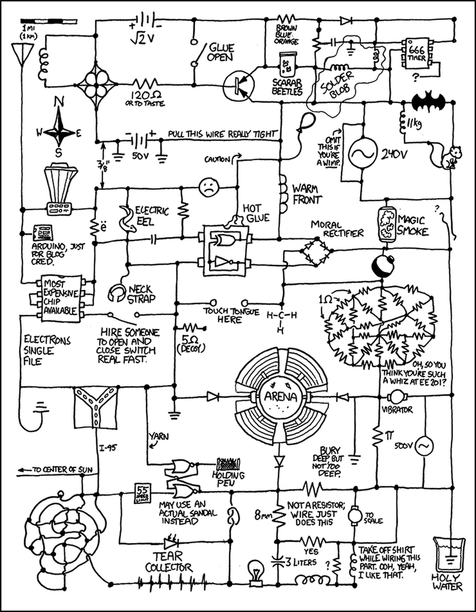
DATAFLOWS
http://www.projectroomseattle.org/programs-content/2014/6/preparing-for-the-failure-variety-show-the-rube-goldberg-confessionals

Slide 106
final dataflow = new Dataflows()
println dataflow.numberOfInteractions
task {
dataflow.numberOfInteractions = dataflow.retweets + dataflow.facebookLikes
}
task {
dataflow.retweets = twitter.numberOfRetweets(article)
}
task {
dataflow.facebookLikes = facebook.numberofLikes(article)
}

Slide 107
final DataflowVariable<Integer> numberOfInteractions = new DataflowVariable<>();
final DataflowVariable<Integer> retweets = new DataflowVariable<>();
final DataflowVariable<Integer> facebookLikes = new DataflowVariable<>();
System.out.println(numberOfInteractions.getVal());
task((Runnable) () -> {
try {
numberOfInteractions.bind(retweets.getVal() + facebookLikes.getVal());
} catch (InterruptedException e) {
throw new RuntimeException(e);
}
});
task(() -> retweets.bind(twitter.numberOfRetweets(article)));
task(() -> facebookLikes.bind(facebook.numberofLikes(article)));

Slide 108
def retweets = new DataflowQueue()
def facebookLikes = new DataflowQueue()
def numberOfInteractions = new DataflowQueue()
operator(
inputs: [ retweets, facebookLikes ],
outputs: [ numberOfInteractions ],
{ retweetsCount, facebookLikesCount ->
numberOfInteractions << retweetsCount + facebookLikesCount
}
)
task {
ALL_ARTICLES.each { article -> retweets << twitter.numberOfRetweets(article) }
}
task {
ALL_ARTICLES.each { article -> facebookLikes << facebook.numberofLikes(article) }
}

Slide 109
final DataflowQueue retweets = new DataflowQueue();
final DataflowQueue facebookLikes = new DataflowQueue();
final DataflowQueue numberOfInteractions = new DataflowQueue();
operator(
asList(retweets, facebookLikes),
asList(numberOfInteractions),
new DataflowMessagingRunnable(2) {
@Override
protected void doRun(Object... arguments) {
getOwningProcessor().bindOutput((Integer)arguments[0] + (Integer)arguments[1]);
}
});
task(() -> ALL_ARTICLES.forEach(a -> retweets.bind(twitter.numberOfRetweets(a))));
task(() -> ALL_ARTICLES.forEach(a -> facebookLikes.bind(facebook.numberOfLikes(a))));

Slide 110
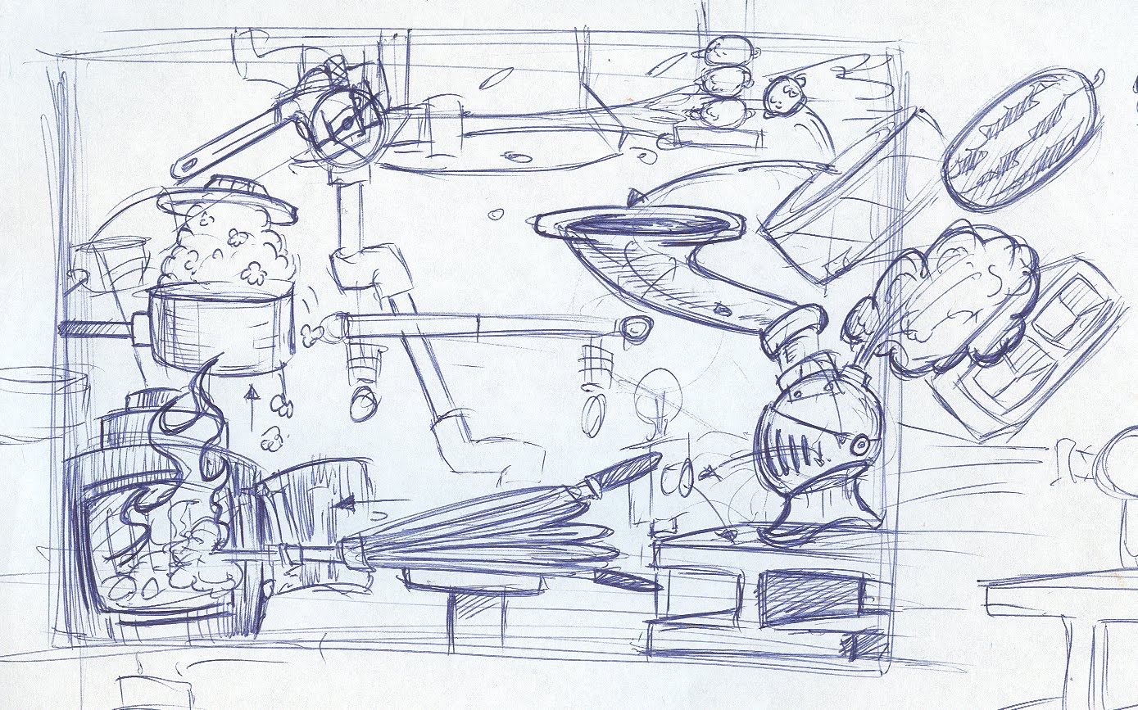
WHY USE GPARS?
WHEN DO USE GPARS? - PARALLEL STREAMS
TO IMPROVE PERFORMANCE OF SEQUENTIAL CODE
SIMPLIFY DEVELOPMENT OF CONCURRENT/PARALLEL CODE
USE CLOSE-TO-DOMAIN ABSTRACTIONS
REDUCE NUMBER OF ERRORS
INTEGRATE DIFFERENT ABSTRACTIONS EASILY
http://sweetlygrotesque.blogspot.com/2012/01/concept-sketches-goldberg-machine.html

Slide 111
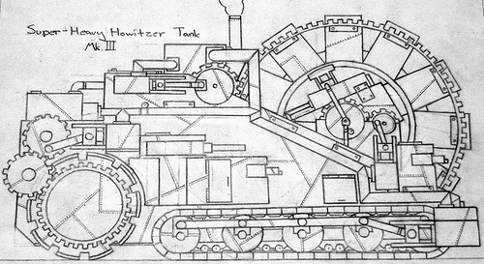
FURTHER DIVE
Examples from slides
Groovy and Concurrency with GPars by Paul King Gpars: Concurrency in Java & Groovy by Ken Kousen
Official site Sources Slack channel
The GPars User Guide 'Concurrent Groovy with GPars' chapter from 'Groovy in Action' book
https://s-media-cache-ak0.pinimg.com/originals/94/7b/55/947b558df61fd46caa6d041c1a21bb40.jpg

Slide 112
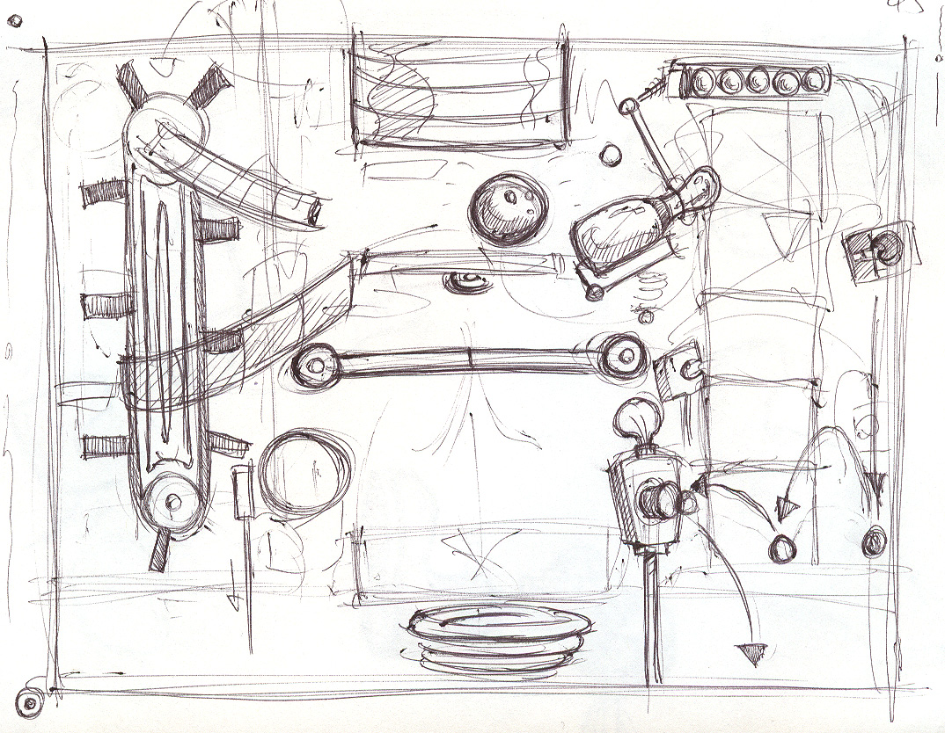
Q/A
THANK YOU!
http://sweetlygrotesque.blogspot.com/2012/01/concept-sketches-goldberg-machine.html

